Slide 1
Areas of Agile transformation

Slide 2
Introduction
Speaker
Pavel Popelka - Head of development unit in Energy
More than five years of practical experience with Agile
Try and adapt on team level (Agile, Management 3.0, Lean…)
Leading the agile transformation in Energy section
Presentation goal
Take always – ideas, thoughts, practices
Share Energy section approach + generic recommendation (experience)
Find own way (different technical, historical background…)

Slide 3
Areas of enterprise influenced by Agile
Agile = adaptive
Applied on several levels (from team to organization).
Areas for succesful agile transformation:
Leadership
Organization
Product
Delivery
Execution
Notes:
notes

Slide 4

Leadership
https://www.solutionsiq.com

Slide 5
Leadership
Creating a vision of Agile transformation
- WHY Agile - collaboration, satisfaction, speed…
- How several ways from change management
Clear and open communication of transformation
- „information radiators“
- transparent, safe information sharing
Energy:
- Openspace
- Slack, Scrumnews, whiteboards…
Leadership dimension

Slide 7
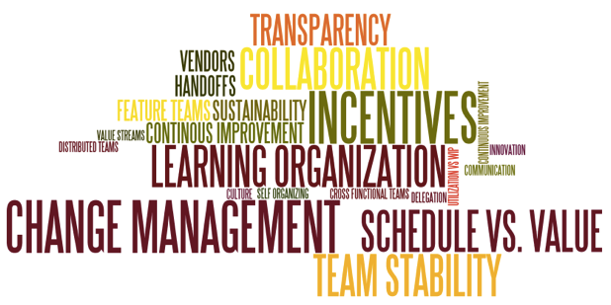
Organization
https://www.solutionsiq.com

Slide 8
Organization
Transition backlog (items supporting agile transition)
- Structures, policies, practices, culture
From individual to team perspective/view
Energy:
- Team targets
- Line structure reorganization
Organization dimension

Slide 9
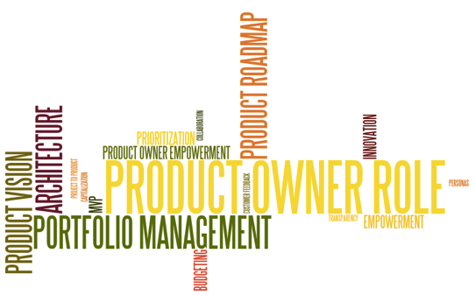
Product
https://www.solutionsiq.com

Slide 10
Product
Clear product definition and boundery
- Energy agile workshops with stakeholders
- Identify your development type
Product owner role
Energy:
- Product vision, roadmaps in Aha!
- Product development
- Product owner TBD
Product dimension
Notes:
- Product development (external customer or market)
- Internal development (internal customer)
- Project development (outsourced development)
Project development - The customer, or client company, includes both the purchasing entity and the users
Product Owner for product development should come from the business side.
Product Owner for internal product development in LeSS is (1) from within the group that will use the system, and (2) is closely involved in and deeply experienced in doing the real work that the system will support

Slide 11
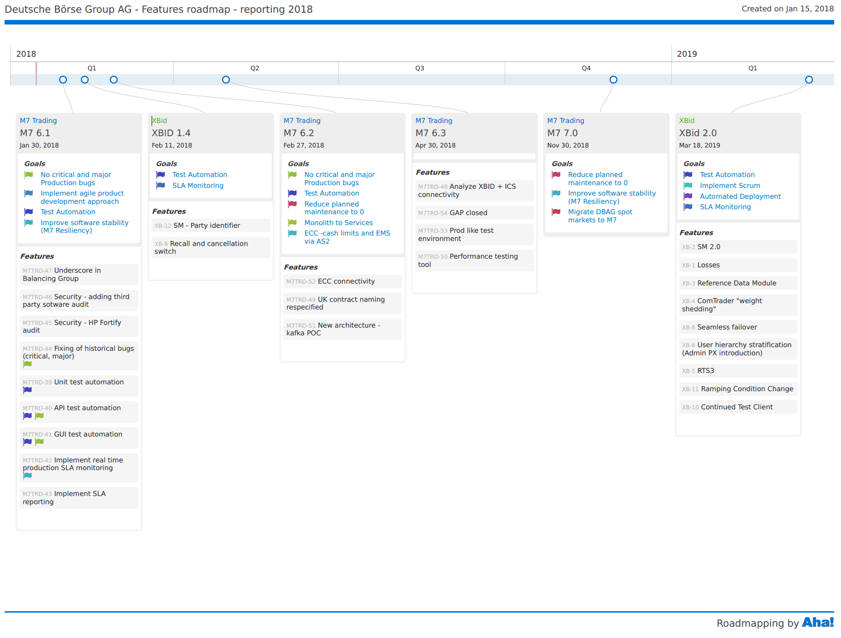

Slide 12
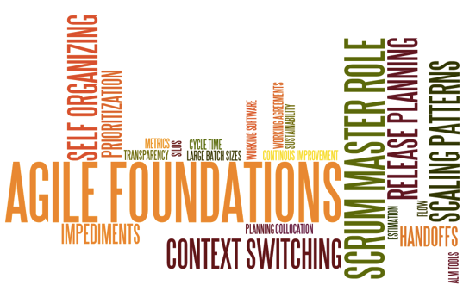
Delivery
https://www.solutionsiq.com

Slide 13
Delivery
Solid foundation of Agile values, principles and practices at the team level
- LinkedIn, Retromat, case studies, conferences…
- Finding the right scaling pattern
Energy:
- Uses Less practices
- Initial workshop with stakeholders
- Initial workshop with teams (mindmap of artefacts)
- Trainings
Scrummaster role
- Recommended to have dedicated fulltime role
- Up to three teams
Delivery dimension

Slide 14
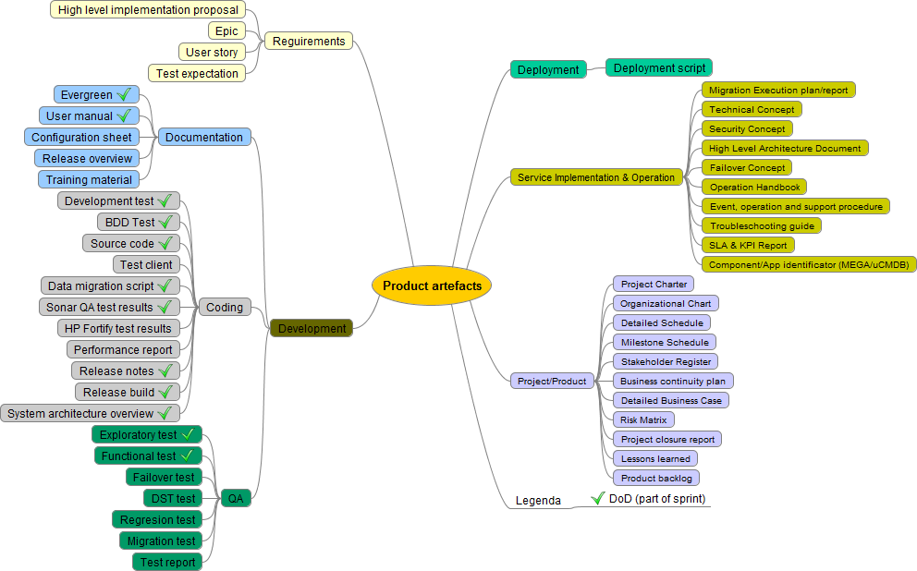

Slide 15

Execution
https://www.solutionsiq.com

Slide 16
Execution
Modern SW engineering best practices
- Automation
- CI/CD
- Monitoring…
Environments, tools … supporting Agile development
Energy:
- QA checks (Sonar)
- CI/CD Jenkins
- AWS testing environments…
- Focus on automation (testing, deployment…)
Execution dimension

Slide 17
Questions and answers

Slide 18
Appendix
Change management methods
- „Fearless change“ by Linda Rising
- „U theory“ by Scharmer
- „Appreciative inquiry“ by Cooperrider
- „Force Field Model“ by Lewins
- Future search
- Openspace (used in Energy)

